Slide 1
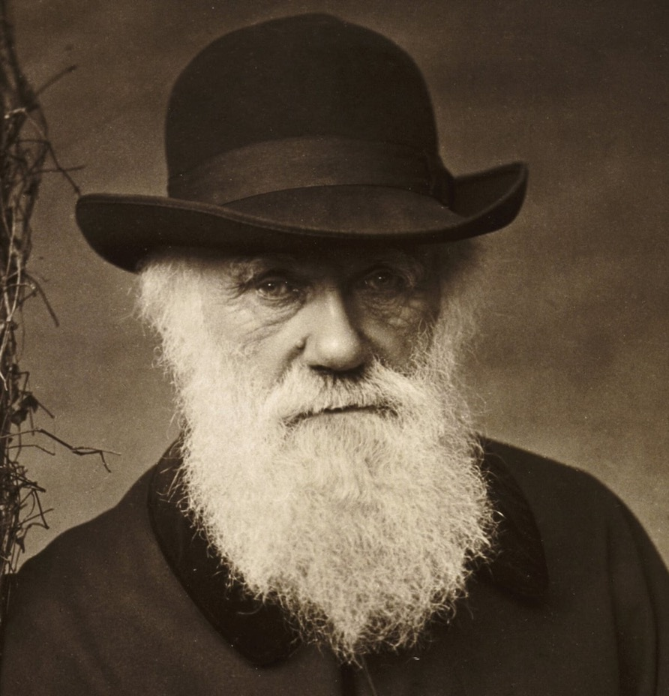
Darwin’s four postulates
Individual variation
Heritability
Differential survival
Differences between generations

Slide 2
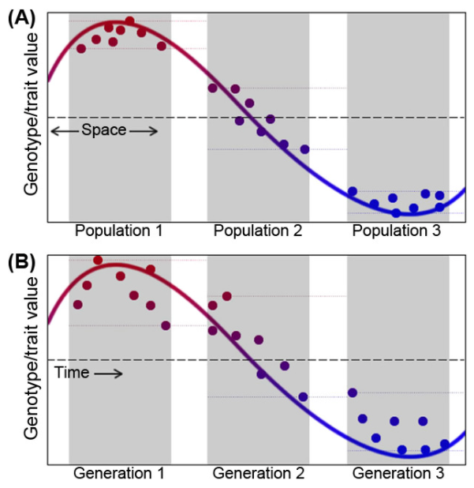
The equivalency of time and space
Temporal sampling of populations can be challenging due to issues with resolution and logistics
Spatial variation provides an alternative to investigate responses to natural selection
Where can we find suitable study systems?

Slide 3
Discussion questions
In relation to the R exercise
What key patterns did you notice when analyzing traits variation in these fishes?
How would body size evolve if there was selection on body size? How would eye size evolve if there was selection on eye size?
How does variation relate to natural selection and evolution?
Additional questions
What is fitness and how do you measure it?
Does natural selection act on the genotype (genes) or the phenotype (physical traits) of an organism?
At what level does natural selection bring about change?
Is evolution random?
Before you get started:
Make sure to introduce each other
Choose a reporter
Breakout groups for 20 minutes

Slide 4
What is fitness?
Fitness is the corollary of selection!
Fitness is a quantitative representation of natural and sexual selection, describing reproductive success
It is defined for specific genotypes or phenotypes and depends on the environmental context
Fitness is equal to the average contribution to the gene pool of the next generation that is made by individuals of the specified genotype or phenotype

Slide 5
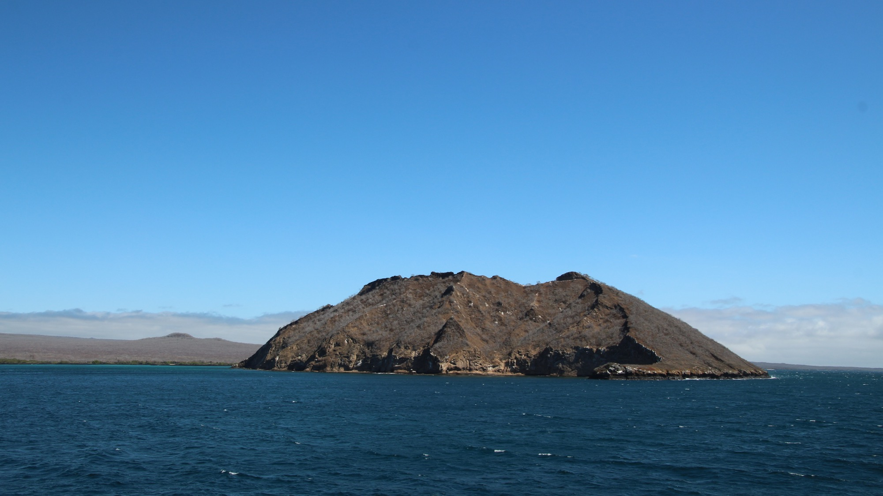
A life on a lonely island

Slide 6
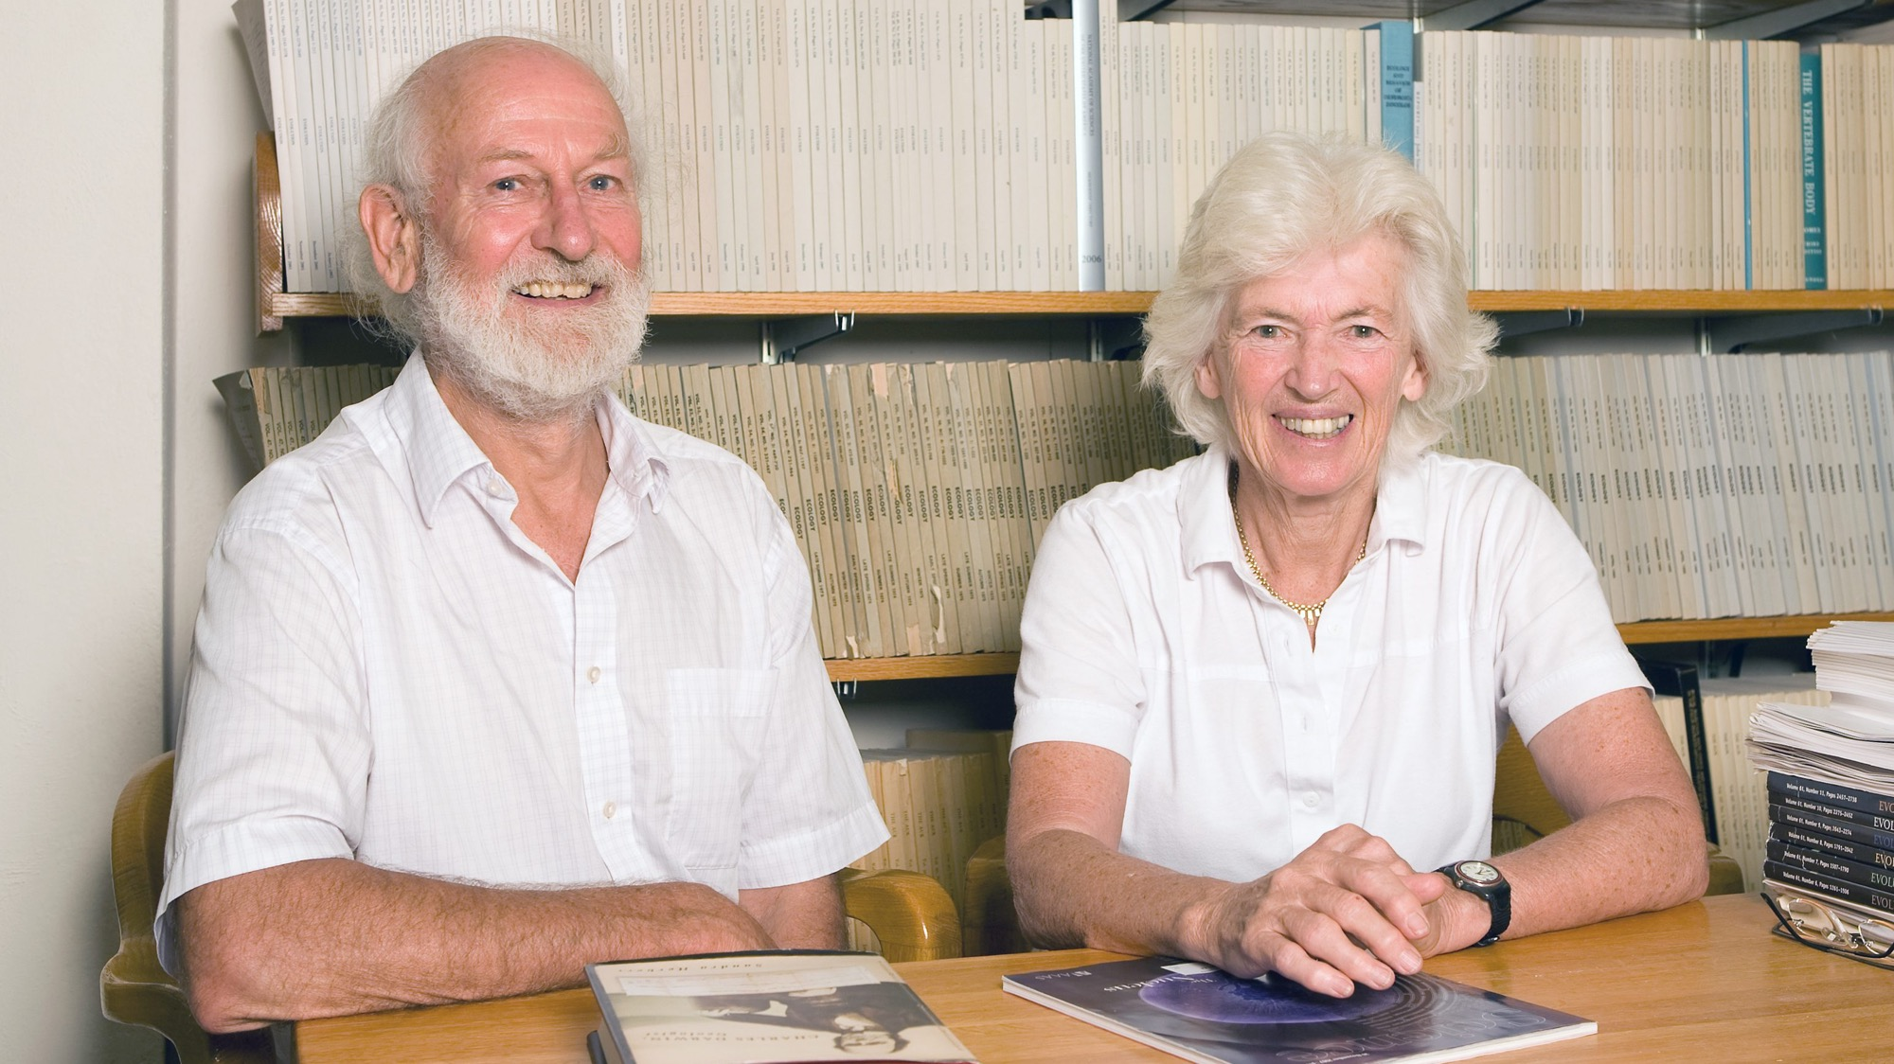

Slide 7
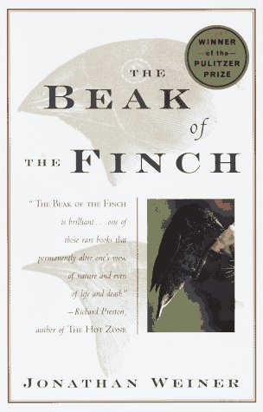
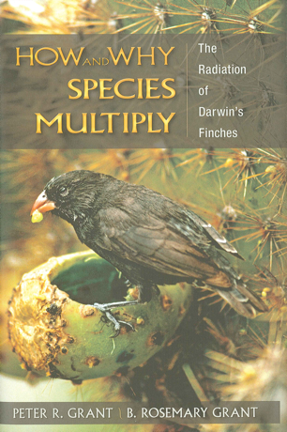
Putting Darwin’s logic to test
Darwin’s finches

Slide 8
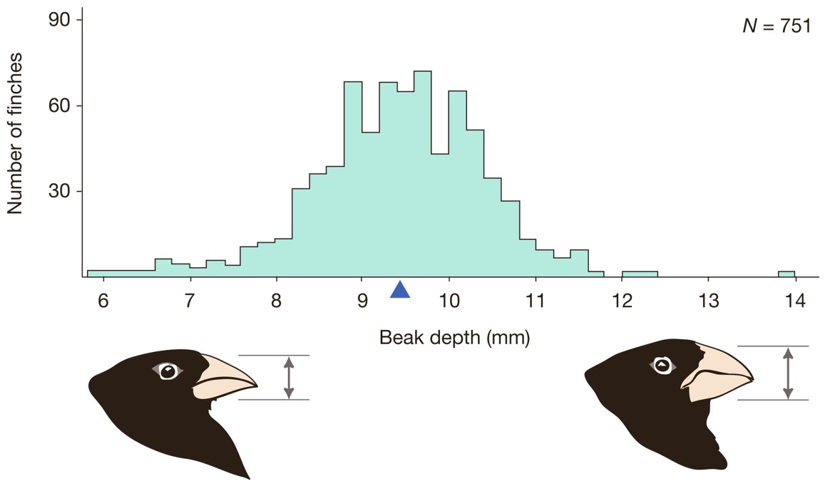
How do finch populations vary?
Darwin’s finches are particularly variable in beak size, both within and among species
In medium ground finches, beak depth can vary two-old within the same population

Slide 9
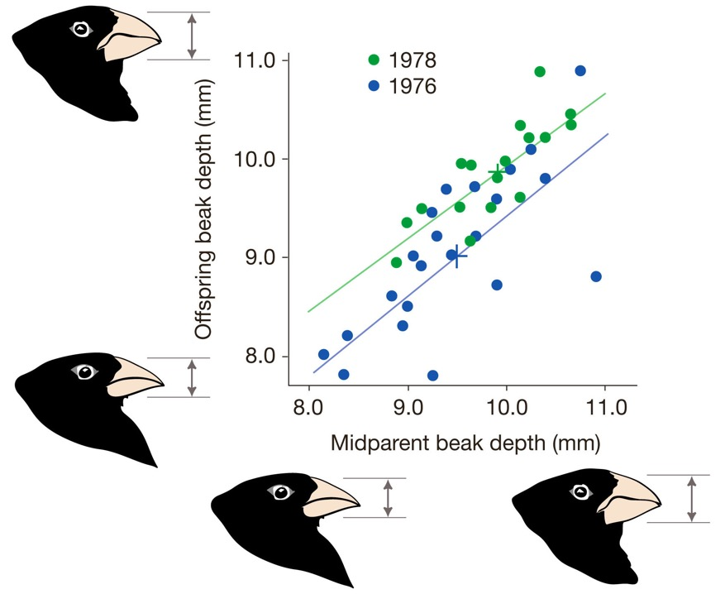
Is there evidence for heritable variation?
Beak size is in parents and offspring is strongly correlated

Slide 10
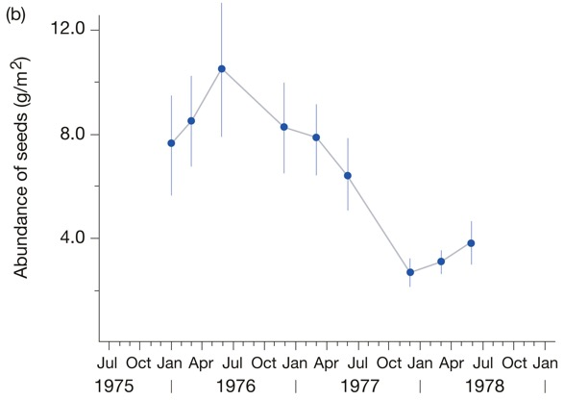
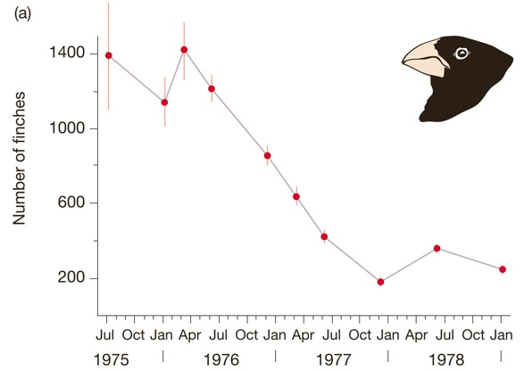
Is there evidence differential survival?
Environmental variation strongly impacts food availability
Adverse environmental conditions can cause massive mortality

Slide 11
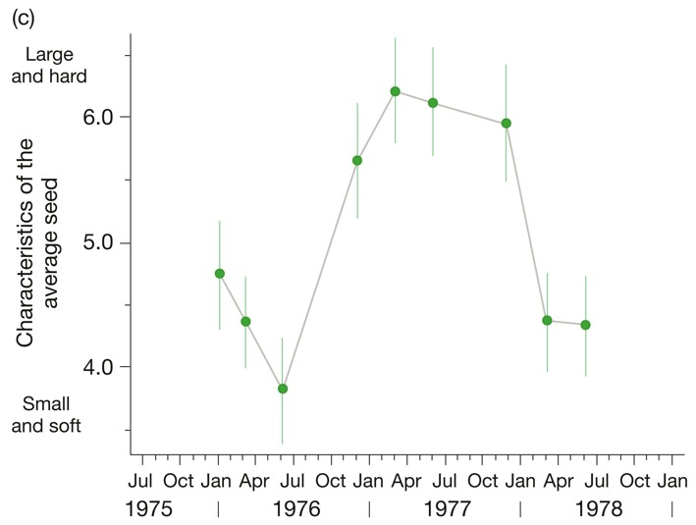
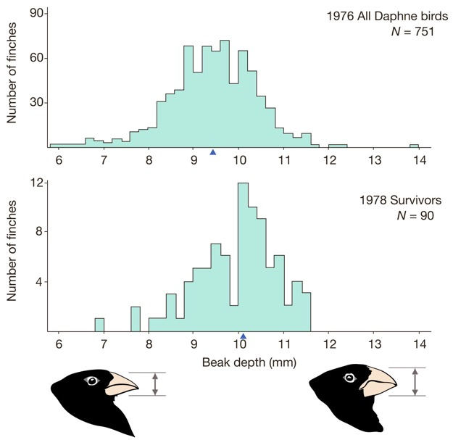
Is there evidence that survival is non-random?
As drought persists, small and soft seeds become more rate
Birds that survived the drought on average had larger beaks

Slide 12
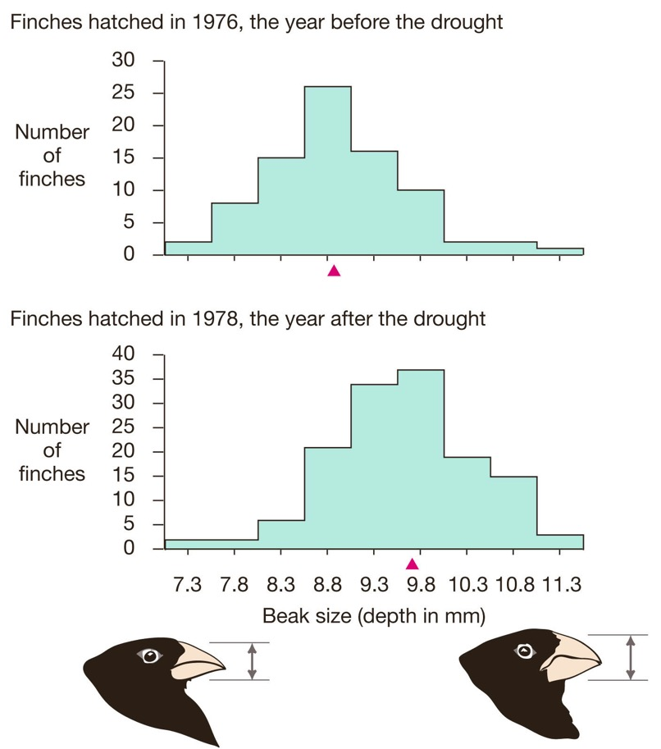
Was there evolution?
Just because survivors had larger beaks doesn’t mean that evolution happened (evolution happens across generations)
Birds born after the drought on average had larger beaks than those born before the drought

Slide 13
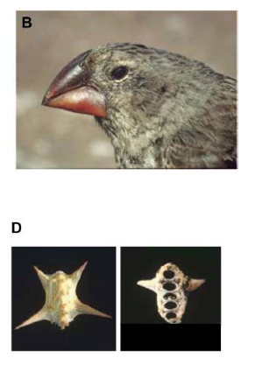
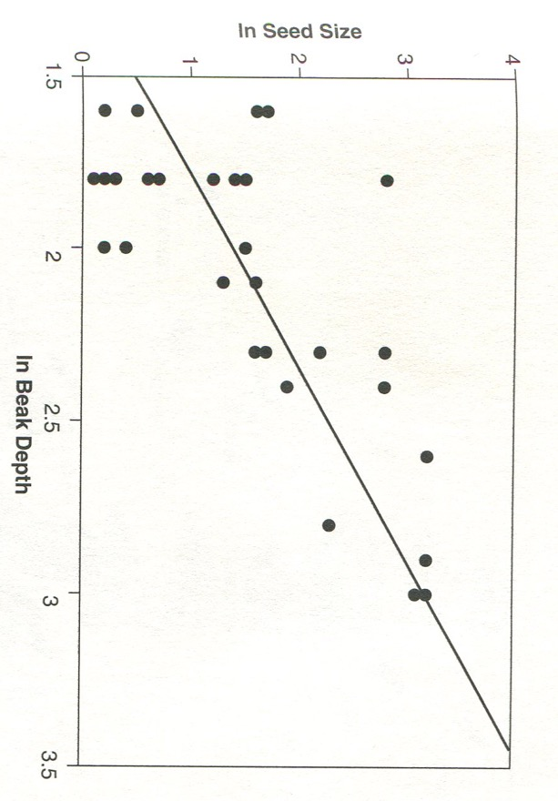
Natural selection acts on individuals
Natural selection does not affect the traits of individuals
Individuals live or die; they reproduce a little or they reproduce a lot
Dead or alive?

Slide 14
Natural selection affects populations
Differential survival and reproduction of individual impacts the composition of subsequent populations
However, there is no evolution after selection when there is no trait heritability
Lived & reproduced
Died

Slide 15
What happened after the drought?
How do you expect the frequency distribution to look like in 1979?
What if hard seeds prevailed on after the initial drought?
Natural selection adapts populations to conditions that prevailed in the past, not conditions that might occur in the future!

Slide 16
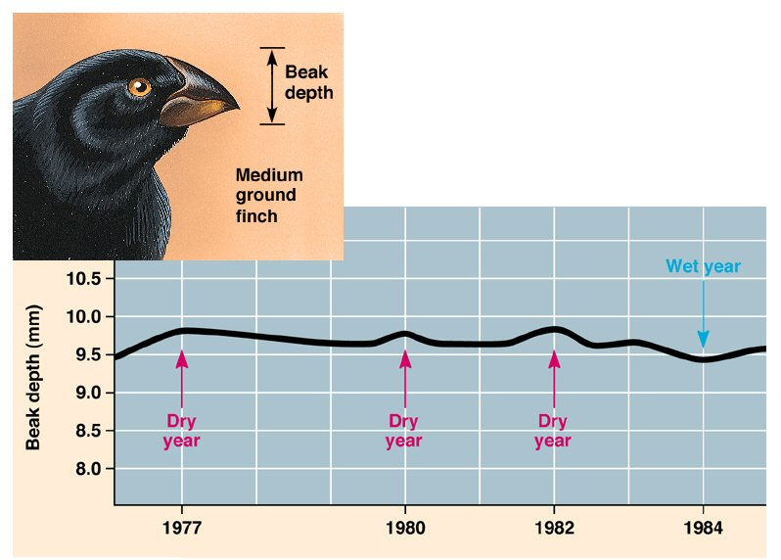
The directionality of selection can vary over time
Fluctuating selection can cause traits to fluctuate around a long-term mean
Unless we sample repeatedly, populations might appear static, and we might miss microevolutionary change

Slide 17
Is evolution a random process or not?
Evolution by natural selection is nonrandom because it increases adaptation to the environment!
Even if nonrandom, the process is free of any entity’s intent, because it acts upon variation generated by random mutation
Convergent evolution is evidence that natural selection leads to predictable outcomes

